Slide 1
Sales Prediction By Cortris
Submitted by
Saumyadeep Roy

Slide 2
Background
A medium-size multinational pharmaceutical company (Company X: client) having a strong presence in the psychiatry segment
They have are the originator of product (Product A: asset) whose patent will expire in January 2024 (patent expiration would allow other companies to introduce a true copy or generic version of Product A leading to price competition).
Company X wants to understand the impact of generic entry in Product A, so that they can develop strategies to mitigate the increased competition due to generic entry.

Slide 3
Objective
The goal for Cortris Consulting is to support client in understanding the impact of generic entry on the innovator product using comparator products (products from other companies not same as Product A, for which patent had expired and operate in similar market conditions), so that our client can decide to develop, invest and further execute their marketing strategy. Hence, the data analysis project stream has the following sub-objectives leveraging the comparator product data:
Develop baseline forecast for Product A (volume).
From current annual sales (2020) to yearly sales one year (2023) prior to generic entry (January 2024).
Sales forecast (annual) following generic entry, Year 1 (2024), year 2 (2025), year 3 (2026), year 4 (2027) and year 5 (2028).

Slide 4
Research Methodology
Data Time period- The data set provided has the sales data of Product A from Jan 2017 to Dec 2020 current annual sales (2020) to yearly sales one year (2023) prior to generic entry (January 2024).
Sales forecast (annual) following generic entry, Year 1 (2024), year 2 (2025), year 3 (2026), year 4 (2027) and year 5 (2028).
Methodology used –We can see this is an Time series analysis and the best suited analysis is ARIMA to do the sales analysis and Linear Regression when there is compition product but we will using Fbprophet algorithm which is

Slide 5
Why our Model?
Prophet is a latest model for forecasting time series data based on an additive model where non-linear trends are fit with yearly, weekly, and daily seasonality, plus sesionality effects. It is opensource and is developed by Facebook
It works best with time series that have strong seasonal effects and several seasons of historical data.
This is an open source library it has both the features of ARIMA and linear Regression it takes into consideration the error(Mean square error) and hence provide better or accurate trend which other models doesnt have
This is model has many used cases also Facebook used it for doing Whatsapp compitation analysis before accuring it

Slide 6
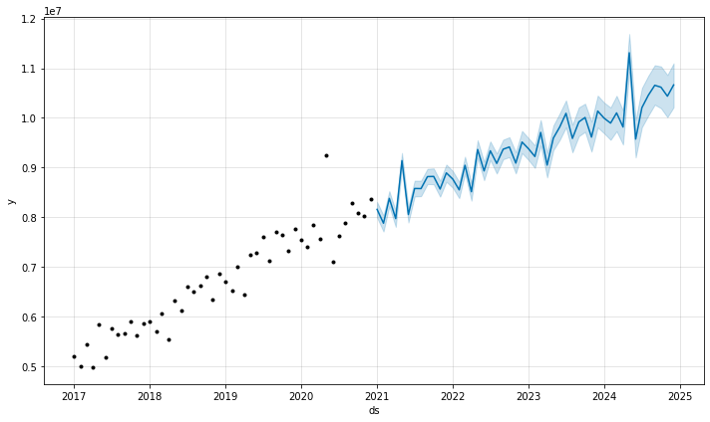
Data Analysis and Limitation
Scenario 1
Product A when there is no compition and predicting the sales trend on the basis of the given data of 2017 to 2020
We have taken the mean of the upper bound and the lower bound to find the trend line
Here we can see that the model takes into consideration the outliers as well
X axis is the years
Y axis the percentage sales volume
(ex- 5199715 is represented as 0.5 for simplicity)
Notes:
Blue area is the upper bound and lower bound and the blue line inbetween is the trend line

Slide 7
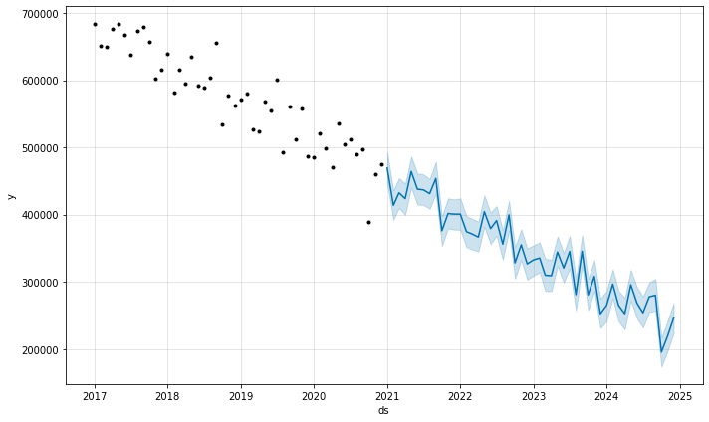
Continued
Scenario 2
Here with the help of the same Prophet model we have found out the sales trend of the compitator and forcasted the sales till 2025
We have taken the Mean of the upper bound and the lower bound to find the trend line
X axis is the years
Y axis is the sales figure
We can see that sales figure is dropping consistantly for the compitation product
Notes:
We have taken compitation product 4 from the given excel dataset sheet 4

Slide 8
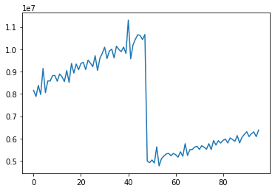
Sales of Product A when compitator enters
Here on condidering that the patent of Product A has ended and compitition eneters the market there is a hugh decline in the sales of Product A
X – sales of product A
Y – no of months
We can also see that after a stiff decline in the sales of Product A again regains growth pattern due to the declining nature of the compitator product

Slide 9
Limitation
Due to time constrain we are only considering one generic product which is Compitator 4 from our excel sheet
We are not considering any sesionality in the sales of product
We are also not deep diving into the price point of the product

Slide 10
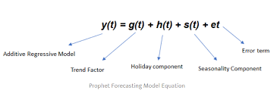
Appendix
What is the model?-
Prophet is a procedure for forecasting time series data based on an additive model where non-linear trends are fit with yearly, weekly, and daily seasonality, plus sesionality effects. It is opensource and is developed by Facebook
Benefit of using this model?-
This is an open source library it has both the features of ARIMA and linear Regression hence combining Scenario 1 and Scenario 2 is easier with this algorithm and the result are more accurate. It takes into consideration the error as well

Slide 11
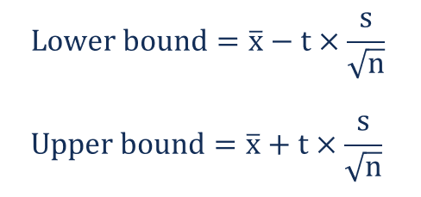
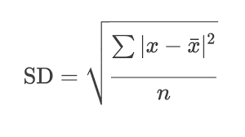
Formula used
Here X is the Mean
t is the T test score
S is the standard deviation
n is the time frame
This was used while finding out the blue area
Here
x is the populaton mean
x bar is the sample mean
n is the time frame
Standard Deviation

Slide 12
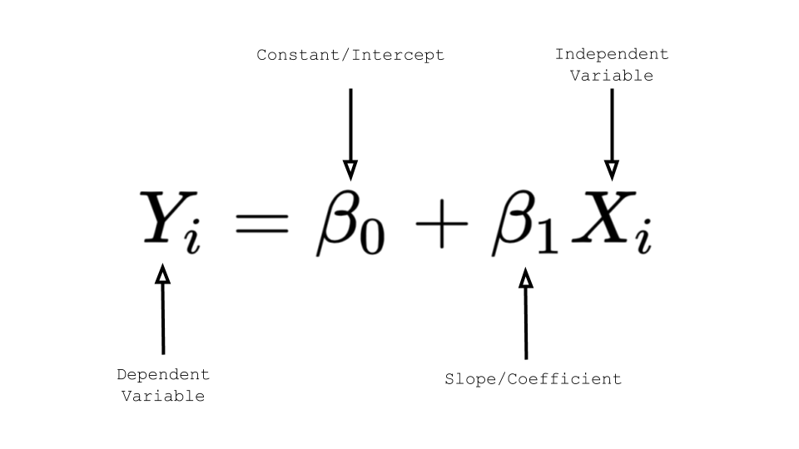
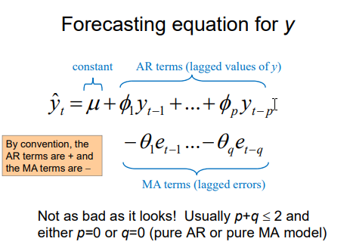
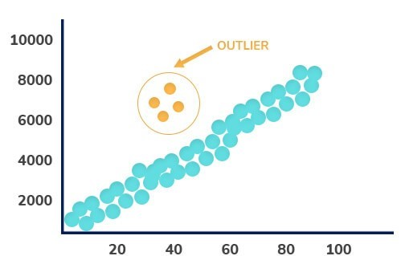
Some Important Concepts our Model
This is Linear Regression formula
ARIMA model
Outlier

Slide 13
Key findings
We can see that till there was no compition Product A was growing rapidly and has almost grown by 2x from 2017 to 2021 and with our forcast it could have grown to 4x if there was no compitition till 2025
From our past data analysis of the compitator product we could find out that the sales of compitator product is constantly dropping which could be beacuse of various resoons like- bad product distribution, ineffectiveness of the drug or managment mis-management
We can also see that after a stiff decline in the sales of Product A when compition product enters market Product A again regains growth pattern due to the declining nature of the compitator product

Slide 14
Thank you

